Slide 1
IBM University Engagement Project Submission
“Exploring the Power of Agentic AI with IBM Granite and IBM BOB”

Slide 2

Project Tile – [Course Content Simplification Agent]
Domain of Project – [Education ]
Student Name | Recent Passport Photo | Email ID | Mobile number [WhatsApp]
Saloni Kumawat |  | salonikumawat324@gmail.com | 8279231061

Slide 3
Problem Statement -
Problem Statement : Course Content Simplification Agent
The Challenge
Educational content is often presented in complex language that is difficult for students with different levels of prior knowledge to understand. Faculty notes, textbooks, and study materials frequently contain technical jargon, lengthy explanations, and advanced concepts that can overwhelm learners. Without personalized, real-time academic assistance, students struggle to grasp key ideas, leading to reduced learning efficiency and engagement..
The Objective
Build an AI-powered Course Content Simplification Agent that delivers personalized learning assistance for students, educators, and academic institutions. The solution should:
Adaptive Content Simplification – Analyze academic content and rewrite explanations based on the learner's proficiency level, such as Beginner, Intermediate, Advanced, or Expert.
Academic Content Analysis – Understand faculty notes, textbooks, PDFs, and study materials to identify key concepts, technical terms, and important topics, then generate simplified explanations and concise summaries.

Slide 4
Interactive Learning Support – Allow users to upload documents or enter text and receive simplified content, keyword definitions, real-world examples, analogies, and answers to follow-up questions.
Personalized Learning Guidance – Recommend study strategies, learning resources, and practice materials based on the student's academic profile, subject, and current level of understanding.
Multi-Agent System –
Content Analysis Agent (extracts and understands academic concepts)
Content Simplification Agent (rewrites content based on the selected learning level)
Learning Assistance Agent (provides explanations, examples, analogies, and answers student queries)
Assessment & Practice Agent (generates summaries, quizzes, flashcards, and practice questions)
Learning Dashboard – Display uploaded documents, simplified content, generated summaries, quizzes, flashcards, learning progress, bookmarked topics, and personalized study recommendations.

Slide 5
Proposed Solution -
Proposed Solution: Course Content Simplification Agent
The proposed solution is a multi-agent AI-powered Course Content Simplification Agent built using Python Flask, IBM watsonx.ai, and Granite Models to provide personalized, real-time learning assistance. The system addresses challenges in understanding complex academic content by intelligently analyzing educational materials and adapting explanations according to each learner's proficiency level through an intelligent, modular architecture.
At its core, the solution uses IBM Granite Models to analyze faculty notes, textbooks, PDFs, and study materials. The AI understands the context of educational content, extracts key concepts, identifies technical terminology, and generates simplified explanations, concise summaries, and personalized learning resources based on the student's selected learning level. The system also supports document upload and interactive question-answering to enhance the learning experience.
The system consists of four key agents::
Content Analysis Agent extracts key concepts, technical terms, learning objectives, and important information from uploaded academic content.
Content Simplification Agent rewrites complex educational material into easy-to-understand explanations tailored to Beginner, Intermediate, Advanced, or Expert learners.

Slide 6
Learning Assistance Agent provides keyword definitions, real-world examples, analogies, personalized explanations, and answers follow-up questions related to the uploaded content.
Assessment & Practice Agent generates summaries, quizzes, flashcards, practice questions, and study recommendations to reinforce learning and improve knowledge retention.
The solution includes a user-friendly responsive web interface built with Flask, HTML, Bootstrap, CSS, and JavaScript, featuring an AI chat interface, document upload, learning level selection, simplified content display, quiz generation, flashcards, dark mode, and a personalized learning dashboard for tracking study progress.
IBM watsonx.ai provides secure access to Granite Models for content analysis, summarization, explanation generation, and adaptive learning. IBM Cloud credentials are securely managed using a .env file, and the application supports deployment on IBM Cloud Lite or local environments.
Overall, the solution provides an AI-powered educational assistant that simplifies complex academic content, enhances personalized learning, and improves student understanding through intelligent content simplification and interactive learning support.

Slide 7
Technology Used
Python Flask – For developing the backend, managing APIs, user authentication, file uploads, and application logic.
IBM Granite Model (e.g., ibm-granite-3-3-8b-instruct) – For academic content analysis, natural language understanding, content simplification, summarization, and personalized learning.
IBM Cloud Lite – Provides a secure, reliable, and scalable cloud platform for deploying the Course Content Simplification Agent.
IBM watsonx.ai – For accessing and deploying IBM Granite models to perform AI-powered content analysis and explanation generation.
SQLite (SQLAlchemy) – For storing user accounts, uploaded documents, chat history, quizzes, bookmarks, and learning progress.

Slide 8
PyPDF2 & Python-Docx – For extracting text from PDF and DOCX files for AI-based processing and simplification.
HTML, CSS, Bootstrap & JavaScript – For building a responsive, interactive, and user-friendly web interface.
Python-dotenv (.env) – For securely managing IBM Cloud API keys and application configuration.

Slide 9
Component Used -
Chat Input – Interface where students enter academic queries or upload study materials (PDF, DOCX, TXT) for simplification and analysis
2) IBM watsonx.ai Agent – Processes user queries and uploaded content using IBM Granite models to generate simplified explanations, summaries, quizzes, and learning support.
3) IBM Granite Model (e.g., Granite-3.3-8B-Instruct) – Performs natural language understanding, content simplification, summarization, keyword explanation, and personalized educational assistance.
4) Chat Output – Displays AI-generated simplified content, summaries, explanations, examples, quiz questions, and answers to student queries.
5) File Upload Component – Allows users to upload PDF, DOCX, and TXT files, extracts the text, and prepares it for AI-based analysis and simplification.
6) Learning Level Selector – Enables users to choose their proficiency level (Beginner, Intermediate, Advanced, or Expert) so the AI can tailor explanations accordingly.

Slide 10
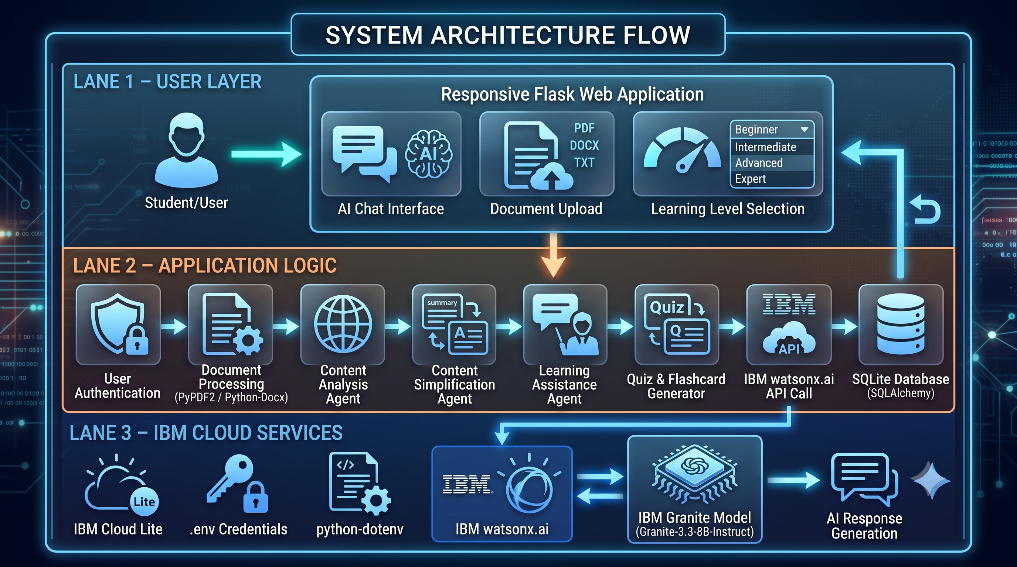
Architecture blueprint

Slide 11
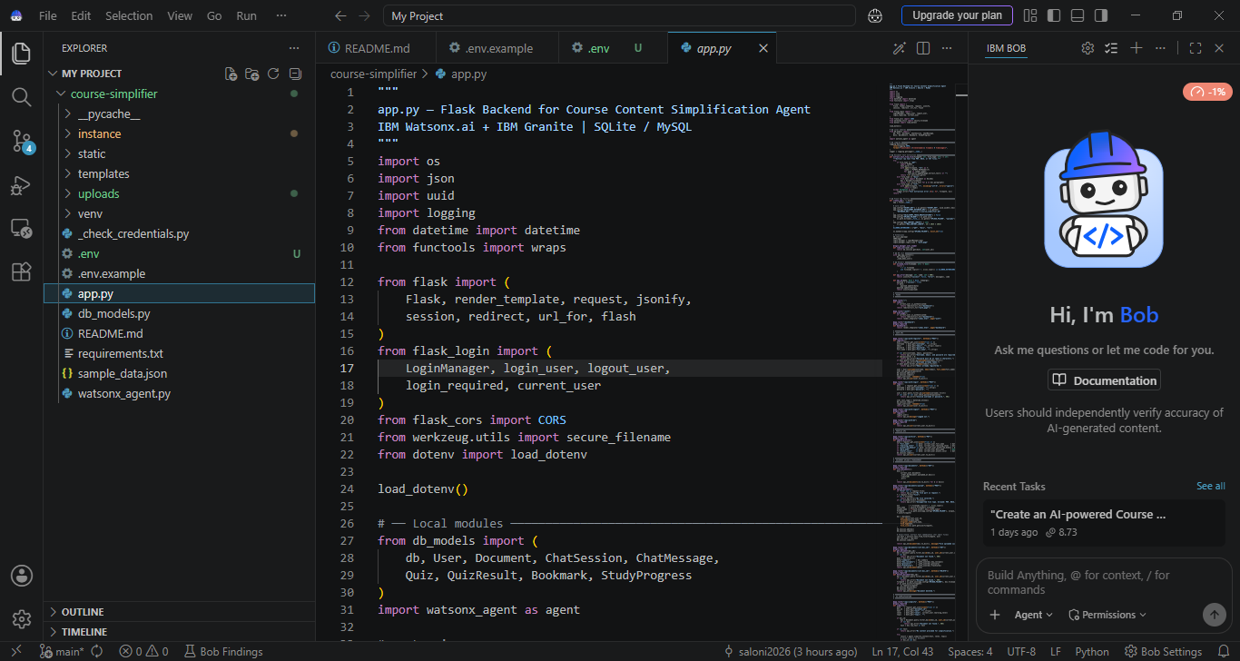
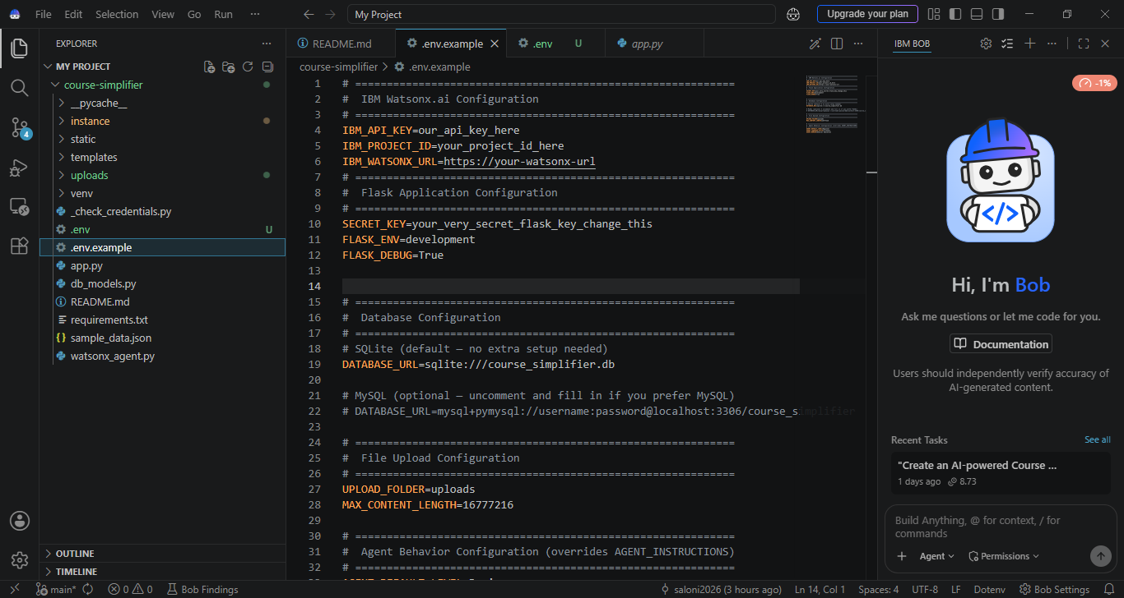
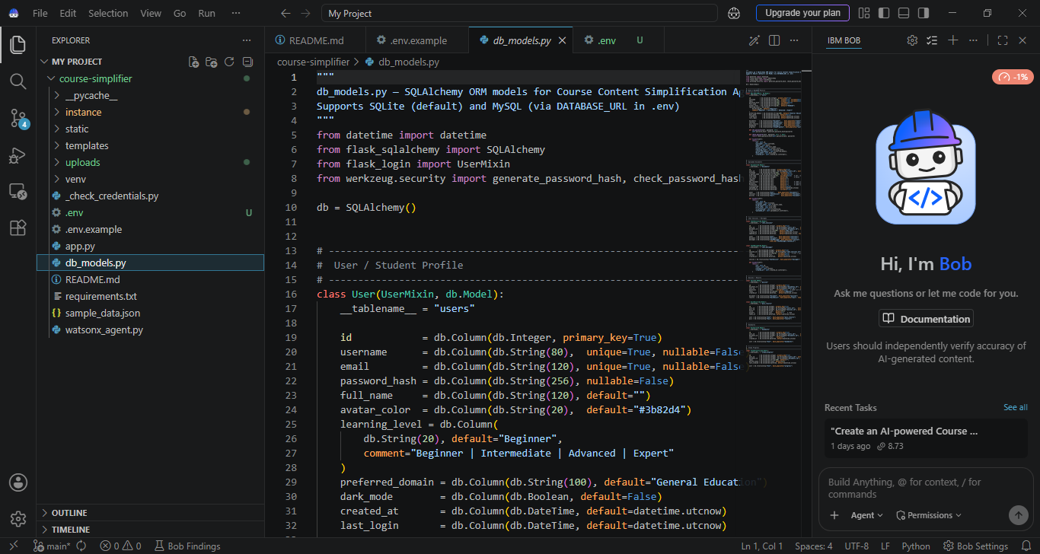
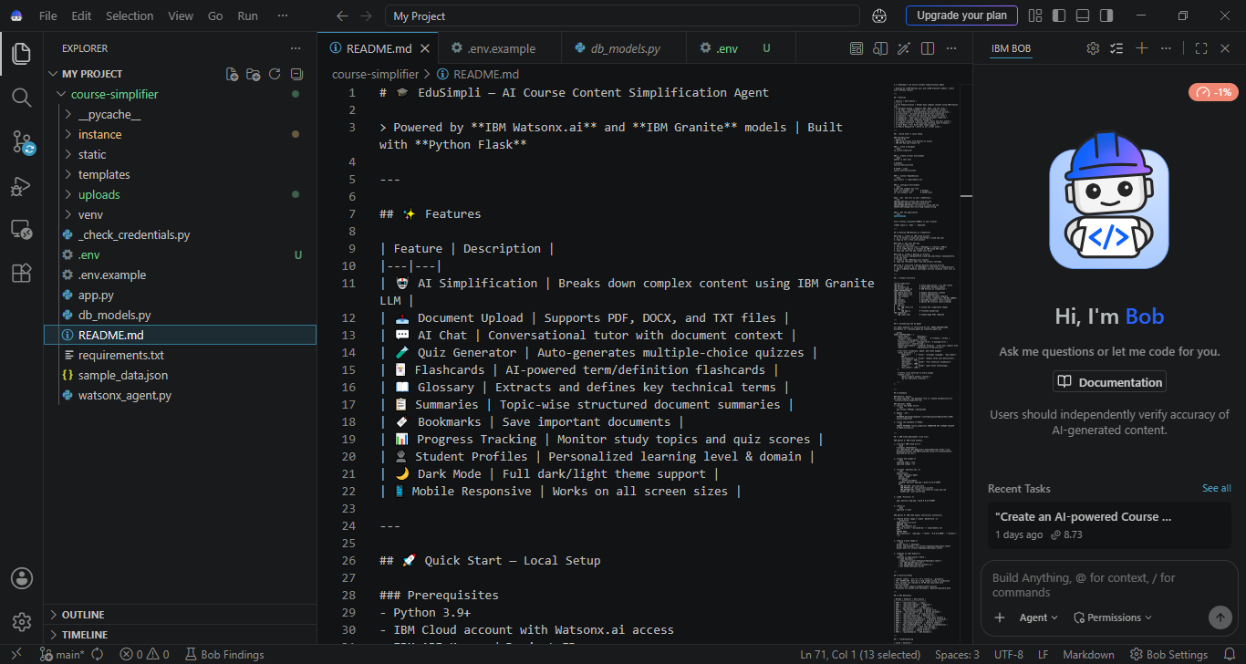
IBM BOB Screenshot

Slide 12
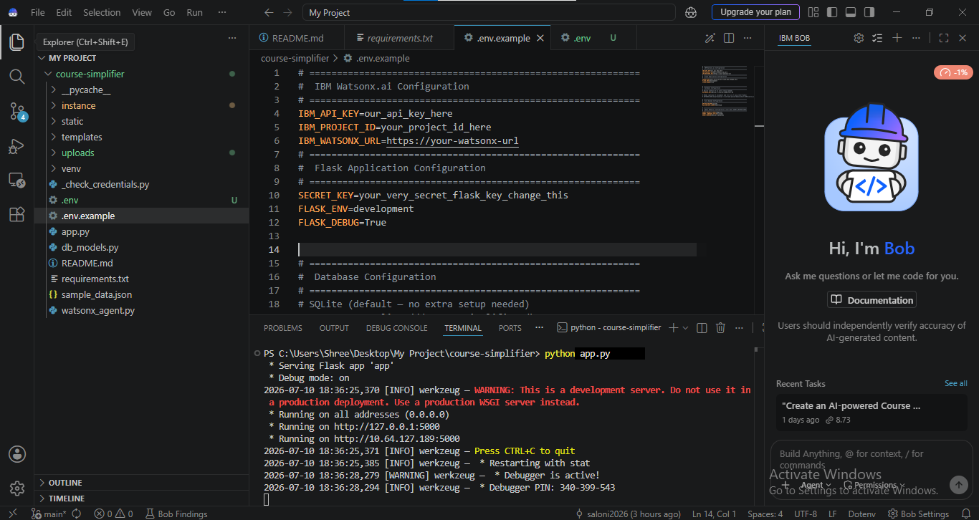
IBM BOB Screenshot

Slide 13
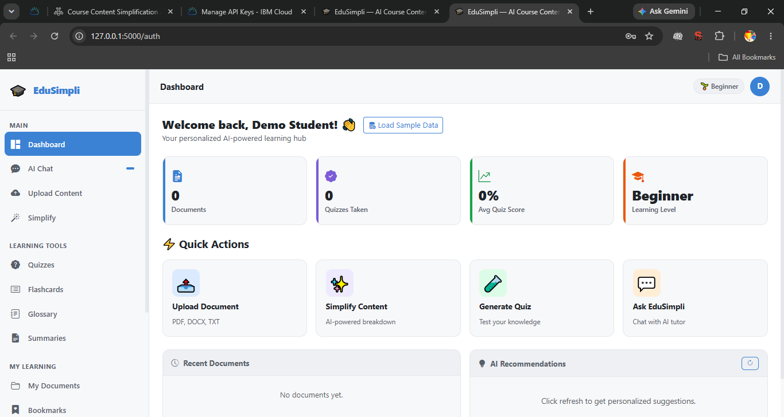
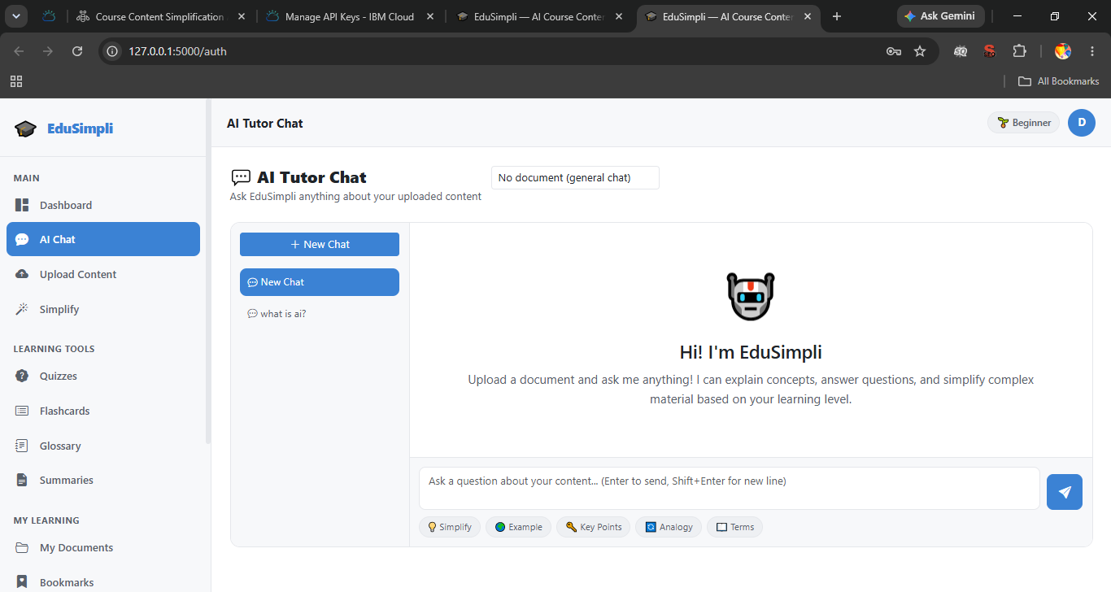
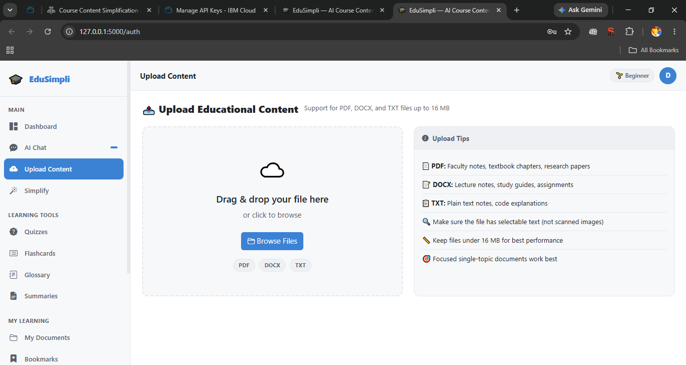
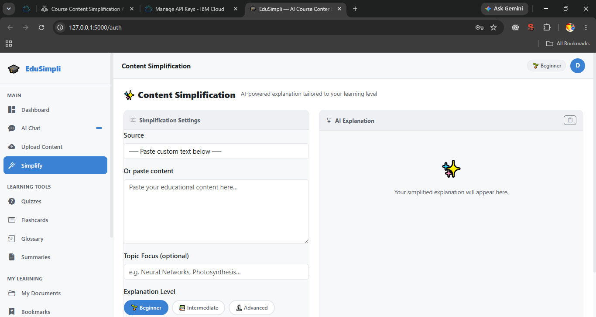
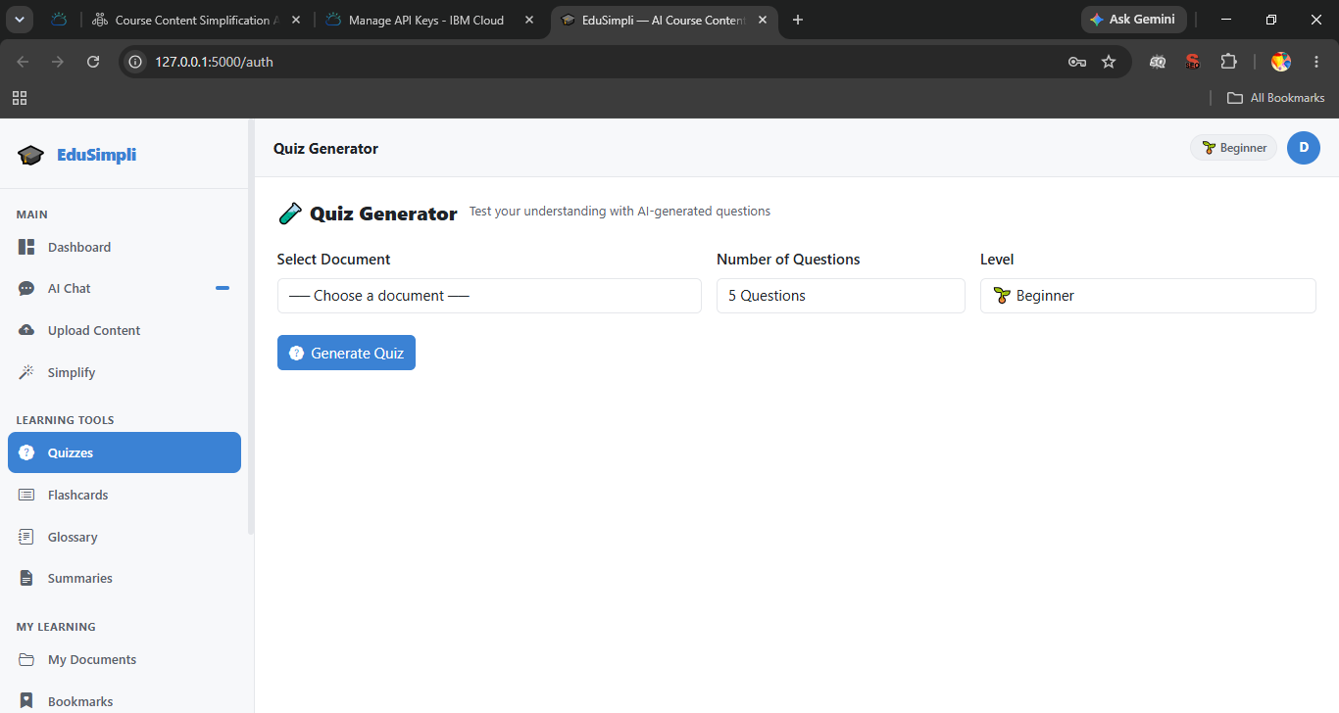
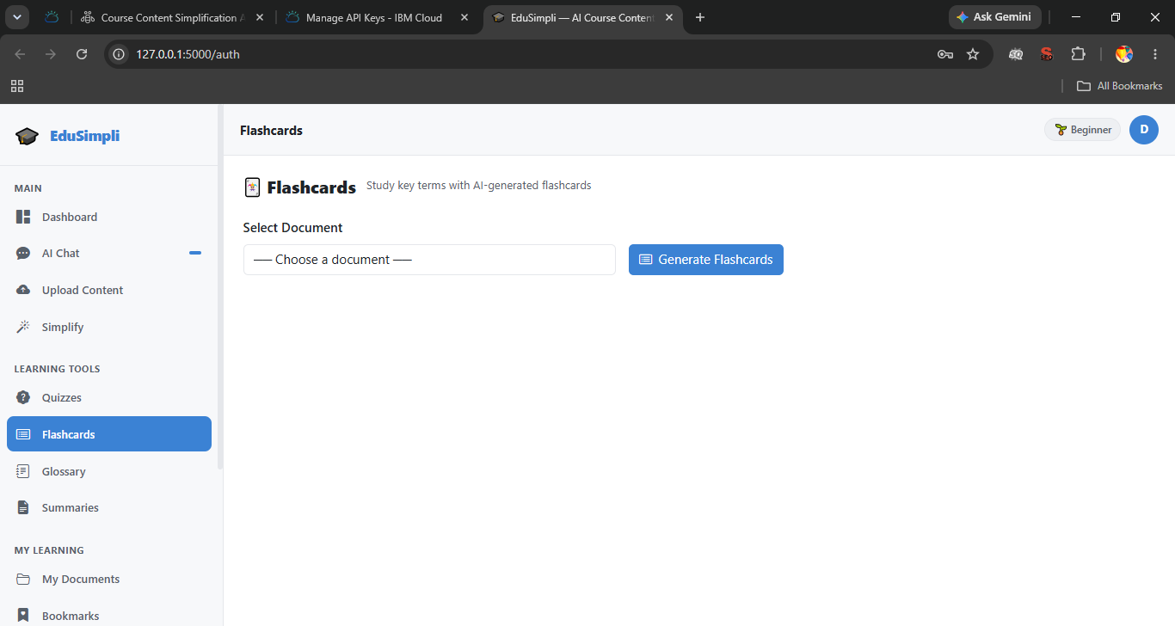
Application Screenshots

Slide 14
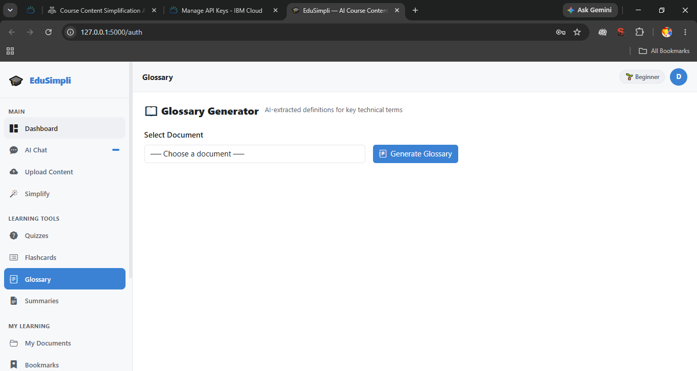
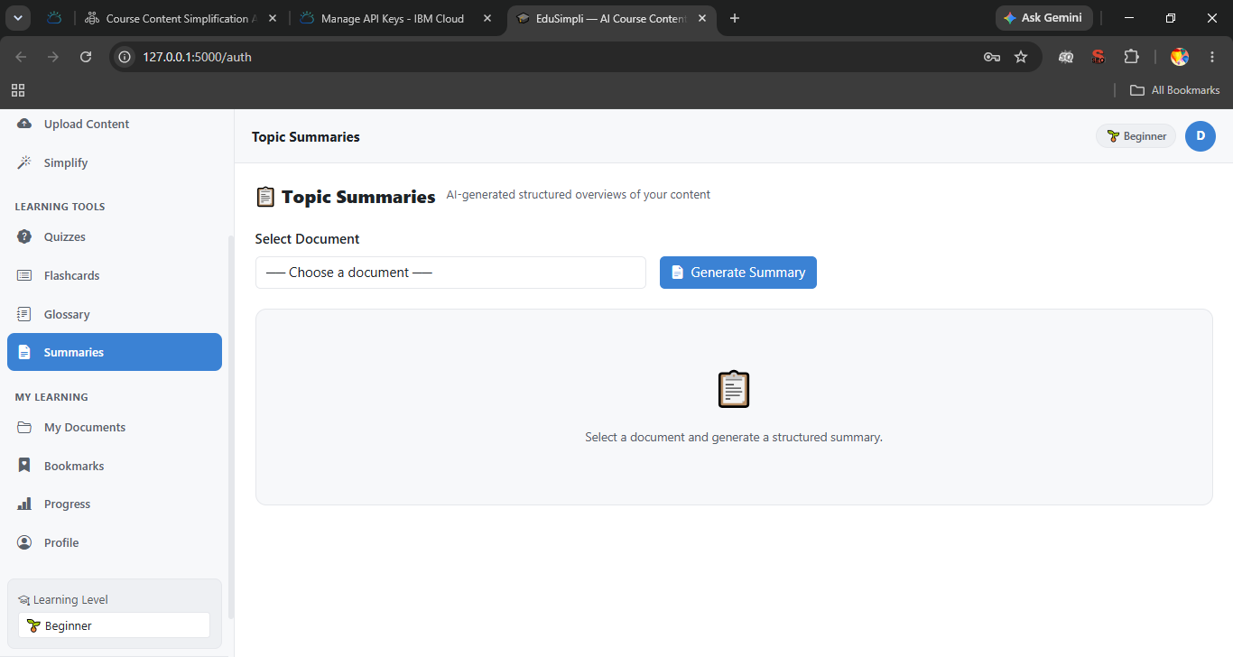
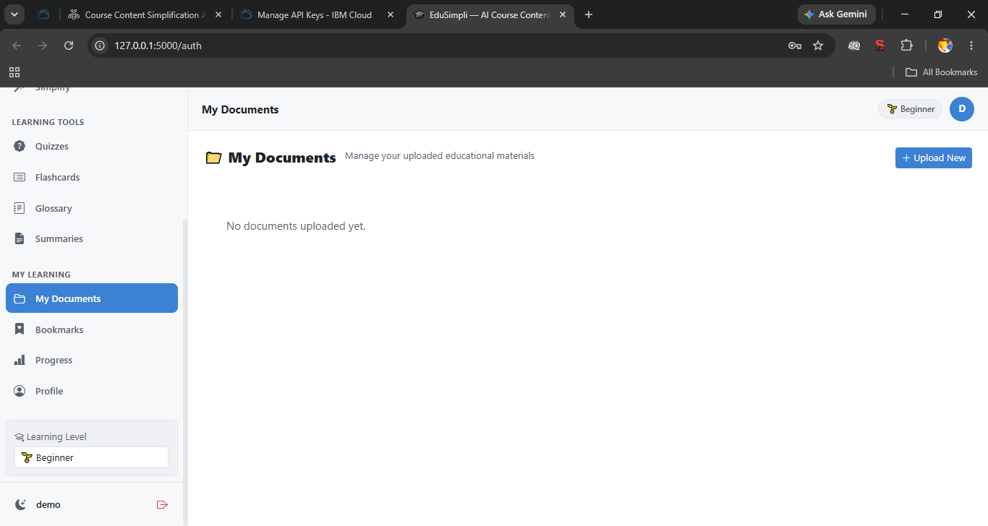
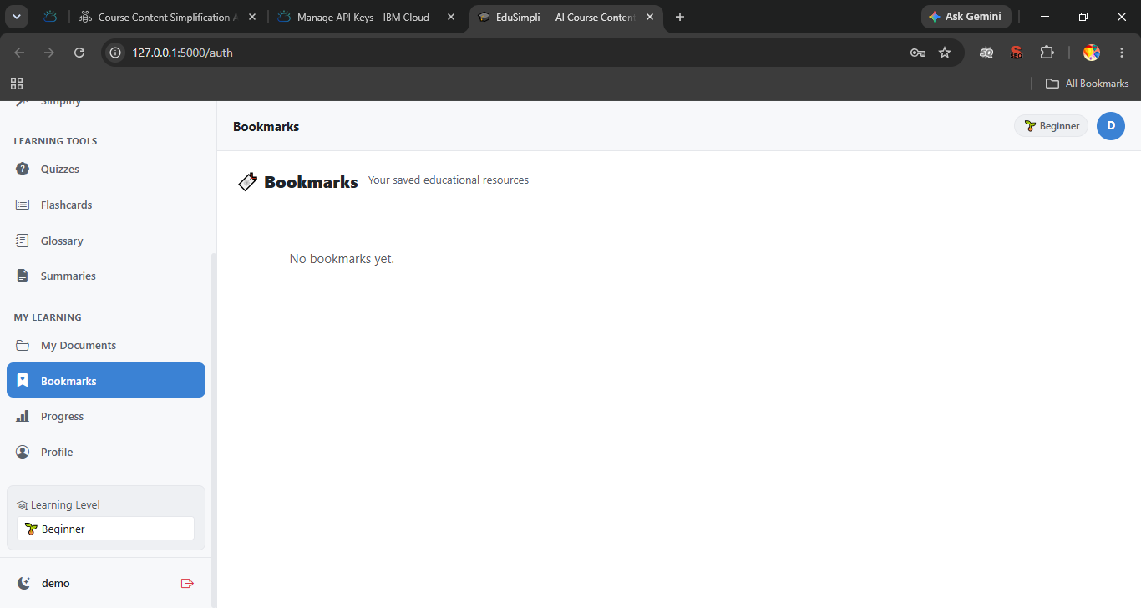
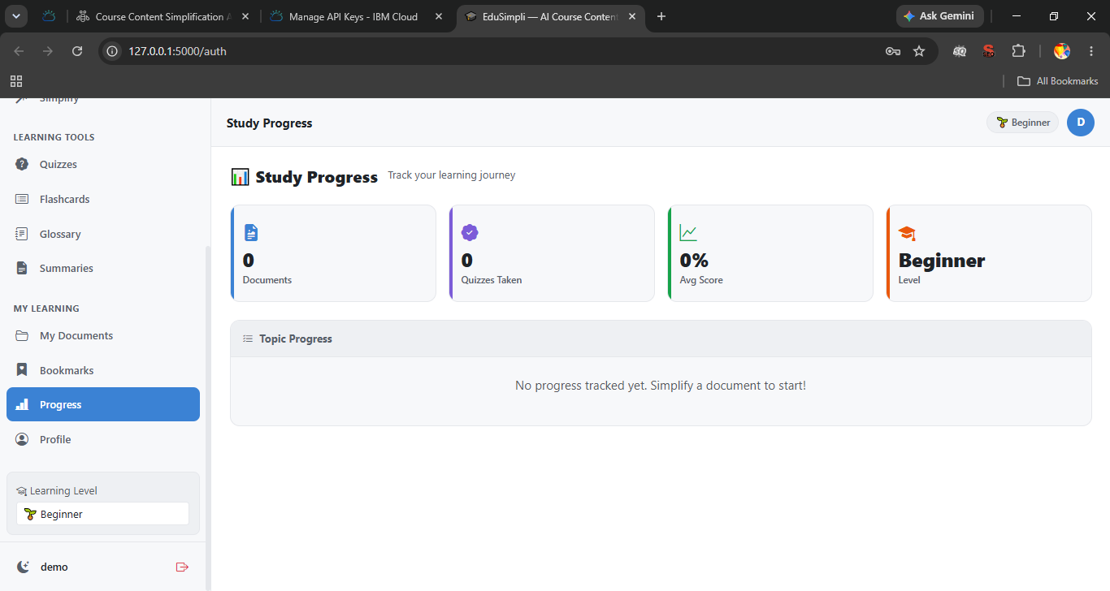
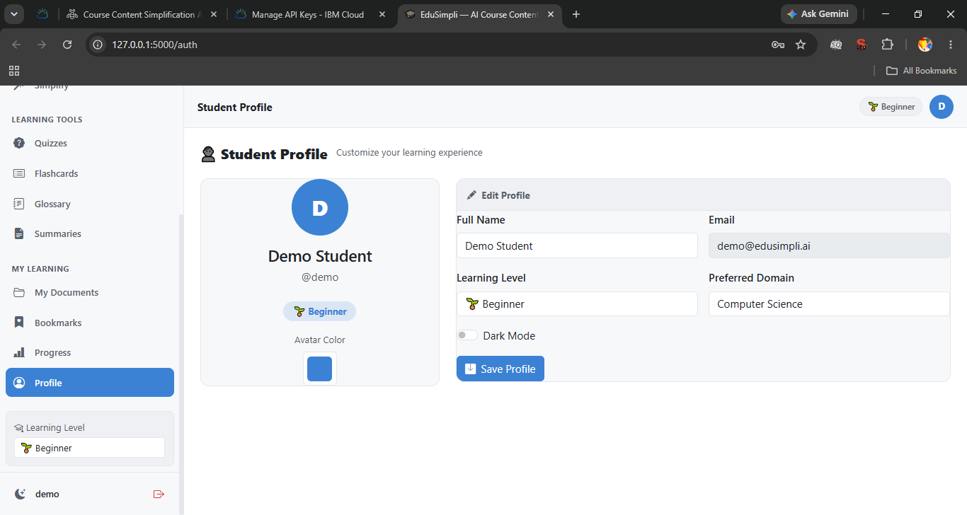
Application Screenshots

Slide 15

Role of Agentic AI in the solution
Role of Agentic AI in the Course Content Simplification Agent
Agentic AI in the Role of Course Content Simplification Agent
The Agentic AI helps the Course Content Simplification Agent become a learning assistant instead of becoming just another chatbot using the IBM watsonx.ai and IBM Granite model where different agents are coordinated for providing personalized learning services.
The different roles of each agent include analysis of the academic content, simplification of complex concepts, summarization of the academic content, explanation of technical terminology and making of quizzes in a collaborative manner..
The Agentic AI also helps the agents become context-aware about the proficiency level of the learners, subject-wise knowledge and learning preference to give personalized explanations. The Agentic AI also helps in real time adaptation of the content complexity based on user inputs and learning levels.
Additionally, the agents communicate with each other, enabling better content analysis, personalized recommendations, and improved learning outcomes.
Overall, Agentic AI makes the system intelligent, adaptive, and learner-centric, acting as a smart educational assistant that simplifies complex academic content and enhances the overall learning experience.

Slide 16
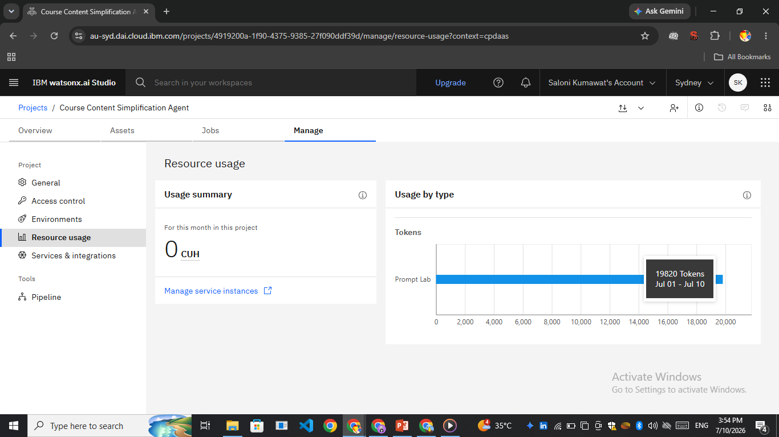
Token Usage
19,820 token are used
·
·
·

Slide 17
Novelty and Uniqueness
The proposed Course Content Simplification Agent combines Agentic AI, IBM Granite models, and personalized learning to make academic content easier to understand for students with different learning levels.
Multi-Agent Intelligence – Multiple AI agents work together to analyze content, simplify complex concepts, generate summaries, explain keywords, and create quizzes for a better learning experience.
Personalized Learning – The agent adapts explanations based on the learner's selected proficiency level, such as Beginner, Intermediate, Advanced, or Expert, making learning more effective.
Interactive Content Support – Students can upload study materials or ask questions in natural language and receive simplified explanations, examples, and follow-up assistance instantly.
Comprehensive Learning Assistance – In addition to simplifying content, the system generates summaries, flashcards, quizzes, and key concept explanations to improve understanding and retention.
AI-Powered Document Analysis – The agent can process faculty notes, textbooks, PDFs, and study materials to identify important topics and present them in a clear, easy-to-understand format.

Slide 18
Modern and Student-Friendly Experience – The responsive interface, learning dashboard, dark mode, and interactive chat make studying more engaging and accessible across devices.
Scalable and Reliable – Built using IBM watsonx.ai and IBM Granite models, the solution provides secure, reliable, and scalable AI-powered educational support.
This makes the solution more than just a content summarizer—it acts as an intelligent learning assistant that adapts to each student's needs, simplifies complex academic material, and supports a more personalized and effective learning experience.

Slide 19
GitHub Repository & Working Demo Video
Github URL - https://github.com/salonikumawat20/My-Project.git
Working demo video Url - https://drive.google.com/drive/folders/1XEcVYM7bdPAxEp8QE-oPHWkULiR-7CX7?usp=sharing
·
·
·

Slide 20
Future Scope
1. AI-Powered Multilingual Learning & Voice Support
The solution can be further improved by adding support for multiple languages and a voice-based assistant feature that would enable students to upload material or post questions in the language they are most comfortable with.
2. Personalized Learning Analytics & LMS Integration
This software can be used together with Learning Management System (LMS) like Moodle and Google Classroom to evaluate students’ performance, suggest study programs and provide adaptive learning according to their results. It will allow teachers to track learning results and provide more efficient teaching.
These future enhancements will make the Course Content Simplification Agent more intelligent, accessible, and suitable for modern digital learning environments.
·
·
·

Slide 21
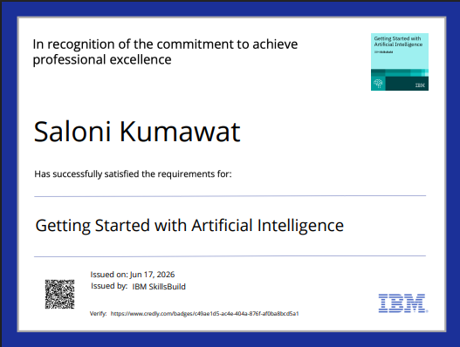
Certificates Earned:

Slide 22
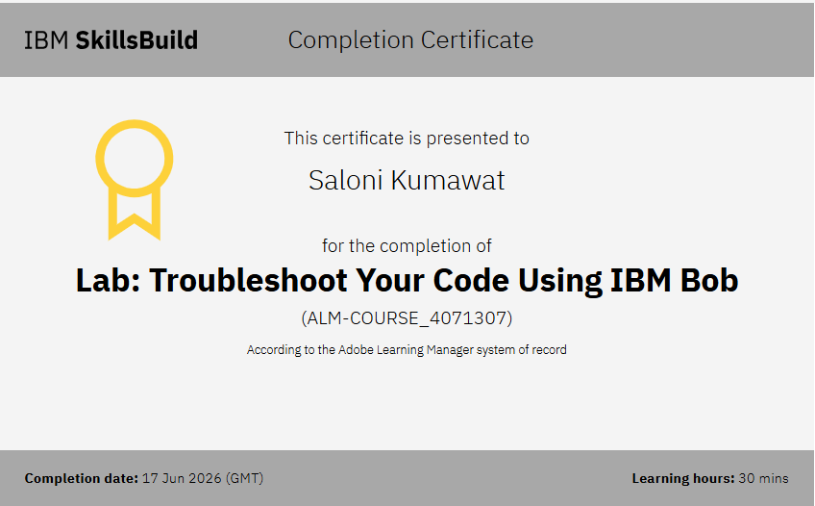
Certificates Earned:​

Slide 23


